Slide 1

THE PHOENIX
MART

Slide 2
TEAM MEMBERS
Arju Adhikari
MD Ashif Ansari
Coordinator
Plant
Nimisha Raut
Sajil Maharjan
Specialist
Team Worker

Slide 3
01 Project Initiation
Project Charter
Meeting Minutes
02 Project Planning
Skills Audit
Project Management (MS Project)
Communication Tools Used
03 Project Execution
Database Design
Use Case Diagram
Logo Design
Wireframe
Requirement Catalogue
Product Development
Table
Of
Content

Slide 4
PROJECT INITIATION
Project Charter
Meeting Minutes

Slide 5



Project Charter
Roles
and
Responsibilities
Version
Control
Project
Scope
Project
Justification
Project
Assumption

Slide 6

MEETING MINUTES
SCHEDULE
AGENDA
LOCATION

Slide 7
PROJECT PLANNING
Belbin Analysis
Skill Audit
Ms Project
Communication Tools Used

Slide 8
SKILL AUDIT
HTML & CSS
Oracle
Frontend
Backend
JavaScript
PHP
.
.

Slide 9





MS PROJECT
Task Sheet
GANTT CHART
Timeline
CALENDER
RESOURCE SHEET

Slide 10
COMMUNICATION TOOL
DISCORD
Github
Gmail

Slide 11
PROJECT EXECUTION
Database Design
Use Case Diagram
Logo Design
Wireframe
Requirement Catalogue
Product Development

Slide 12
Entity

Slide 13
EERD

Slide 15
ERD

Slide 17
De-composite

Slide 18
De-composite

Slide 19
FINAL ERD

Slide 20
Customer Use case

Slide 21
Customer Use case

Slide 22
Customer Use case

Slide 23
Customer Use case

Slide 25
Trader Use case

Slide 26
Trader Use case

Slide 27
Trader Use case

Slide 28
Trader Use case

Slide 29
Trader Use case

Slide 31
Admin Use case

Slide 32
Admin Use case

Slide 33
Admin Use case

Slide 34
Admin Use case

Slide 35
Admin Use case

Slide 36
Admin Use case

Slide 39


REQUIREMENT CATALOGUE
Non-Functional Requirement
Functional Requirement

Slide 40



MoSCoW
Must
Should
Could

Slide 41
Product
All products need details
Interface to navigate products.
Interface to add products in cart and wish list.
Reviewing and rating of products.

Slide 42
Customer
Registration form for new user.
Login form.
View and update profile.
Interface to view product.
Access to cart.
Interface to place order and view order details.

Slide 43
Trader
Registration form for new user.
Login form.
View and update profile.
Shop and product management.
Access to dashboard and report.

Slide 44
Admin
Login form in apex oracle.
Manage trader and user.
Reports.
Payment.

Slide 45
Non- Functional
Responsive.
Heritage reflection.
Password encryption.
Audit Table.

Slide 46



LOGO DESIGN
Logo - Black
Logo -White
Logo -Icon

Slide 47
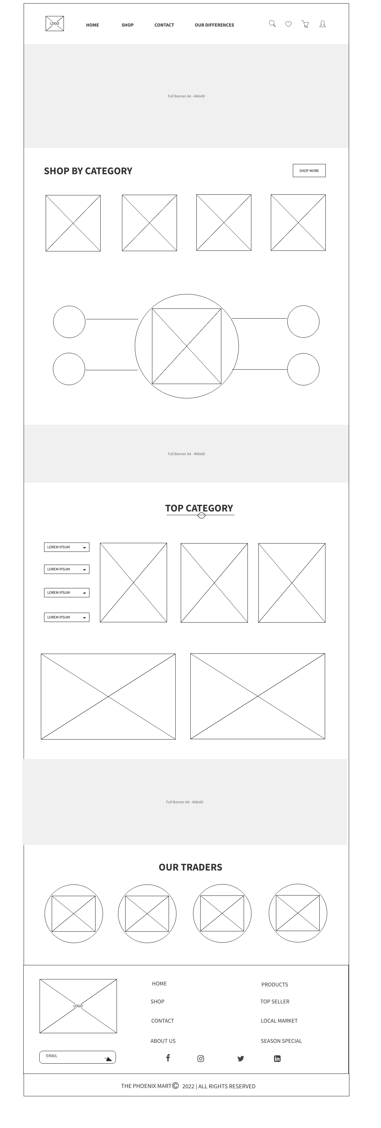
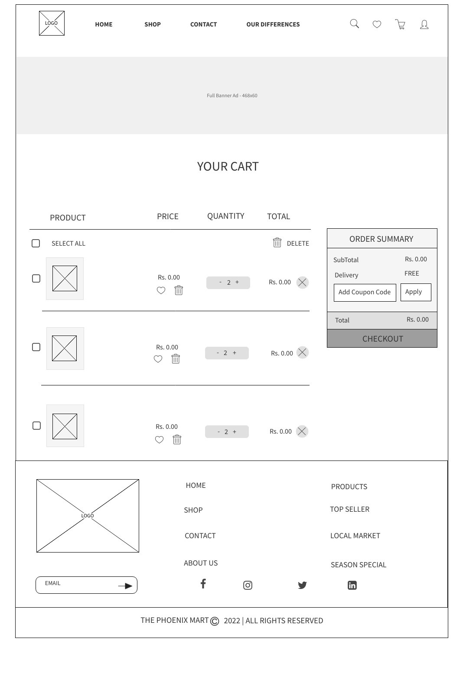
WIREFRAME DESIGN
Home Page
Cart Page

Slide 48
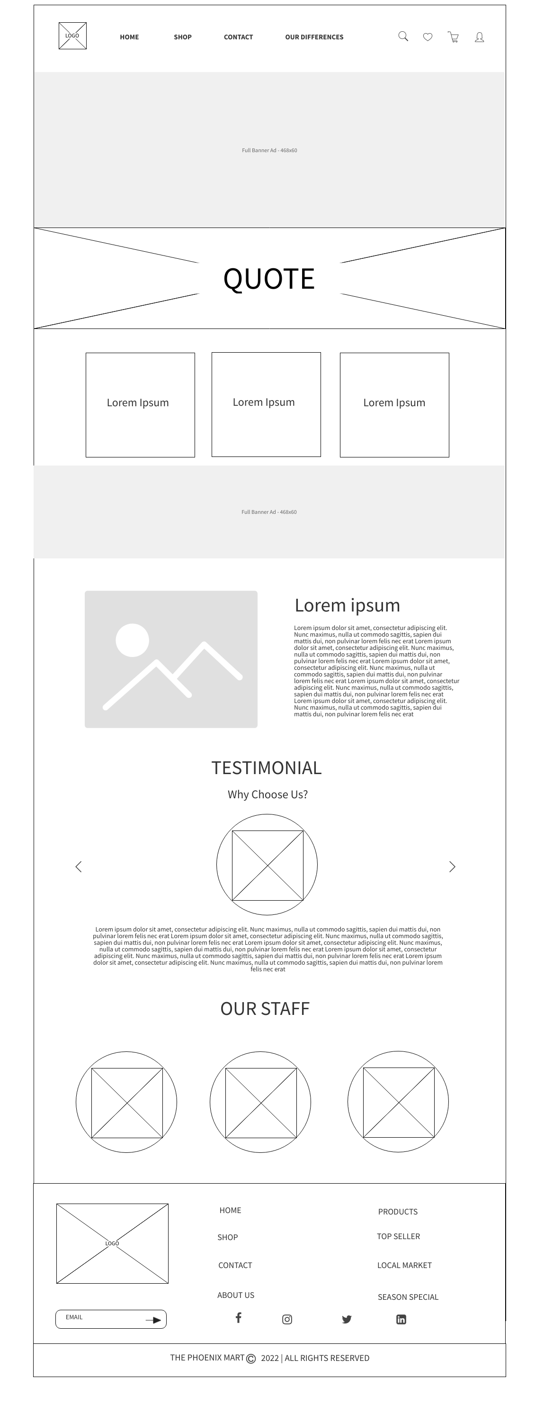
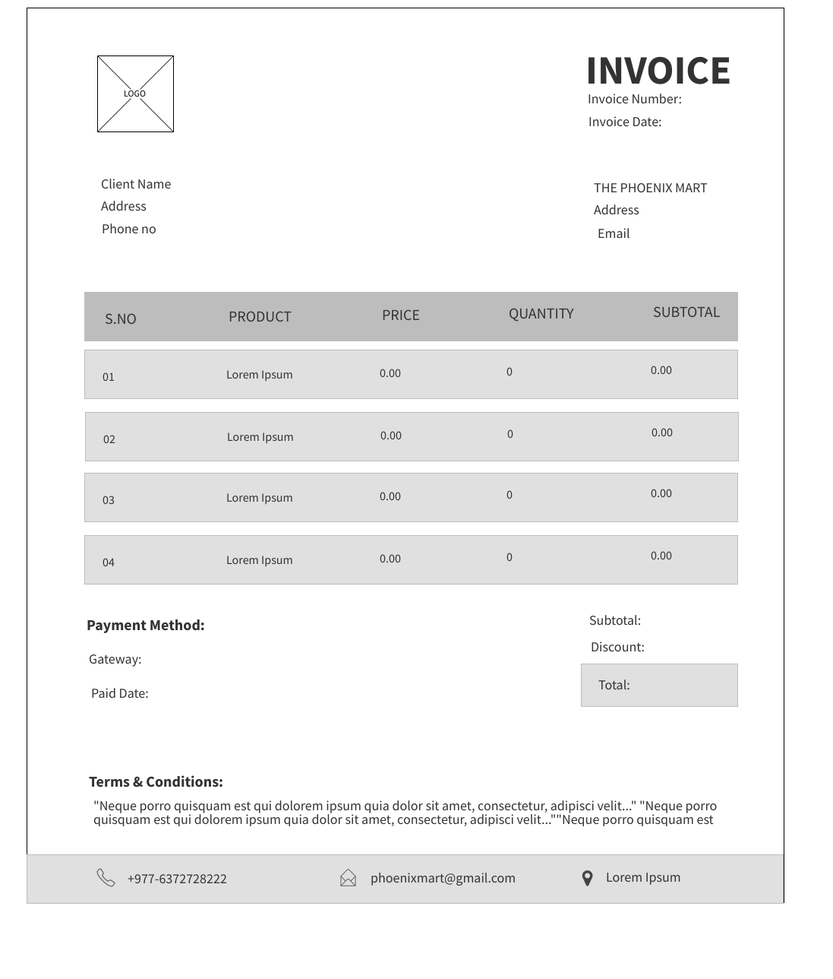
WIREFRAME DESIGN
About Us Page
Invoice

Slide 49
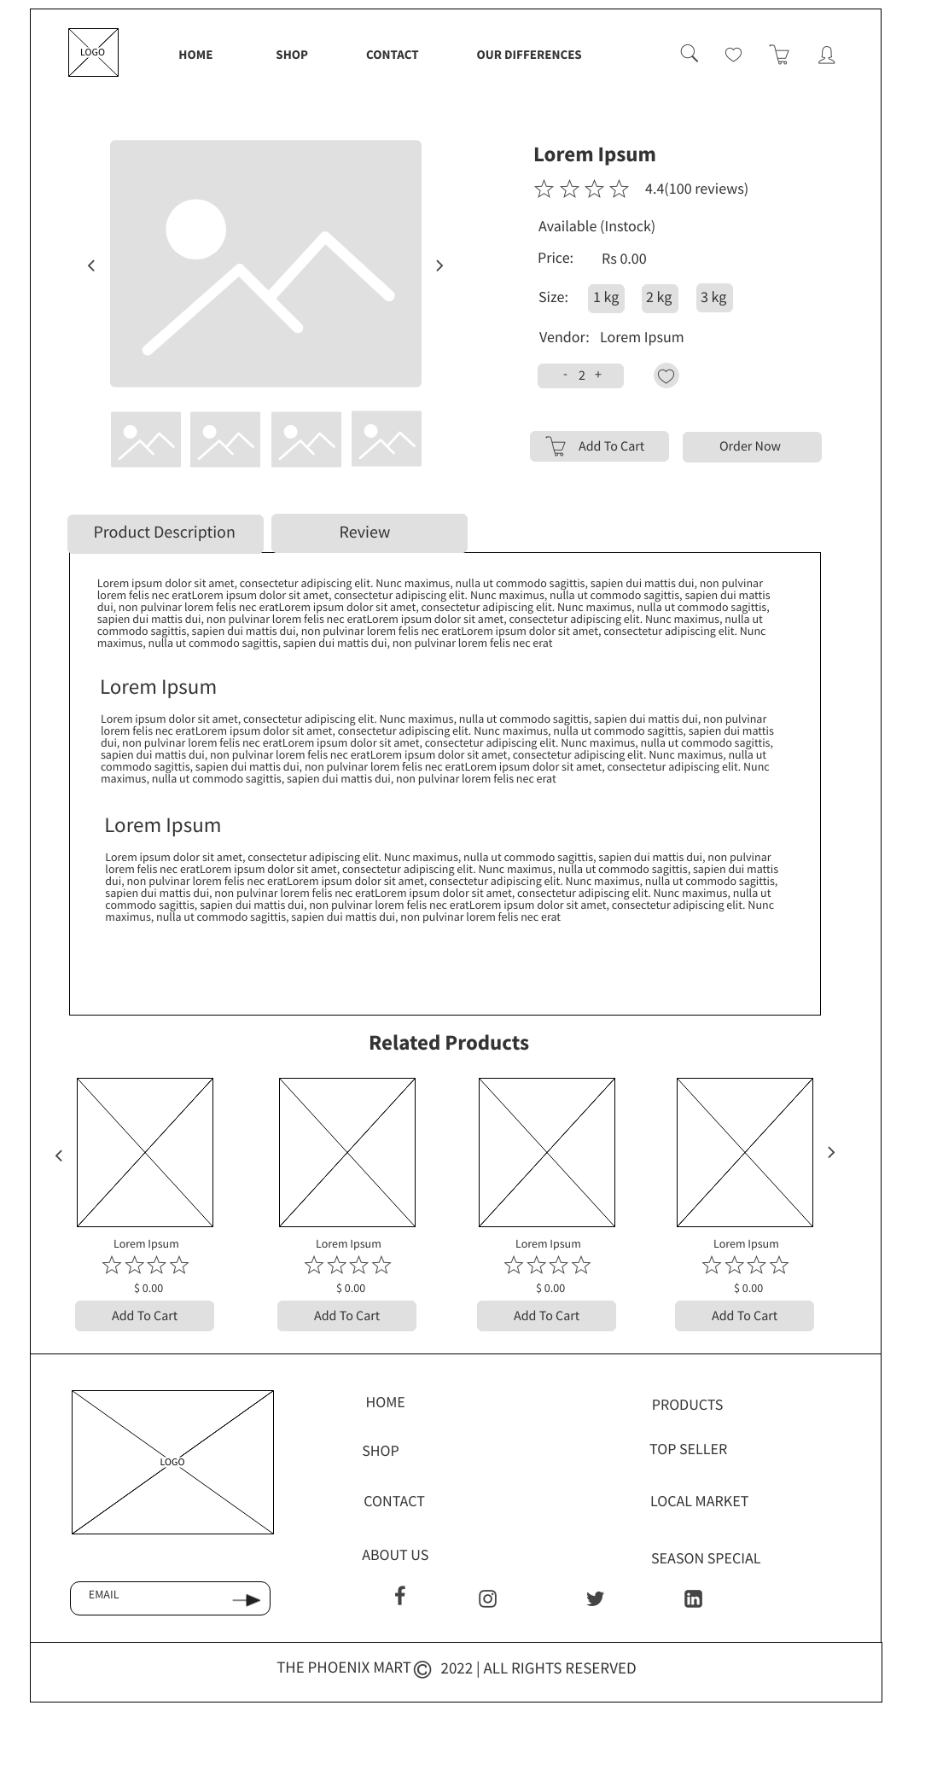
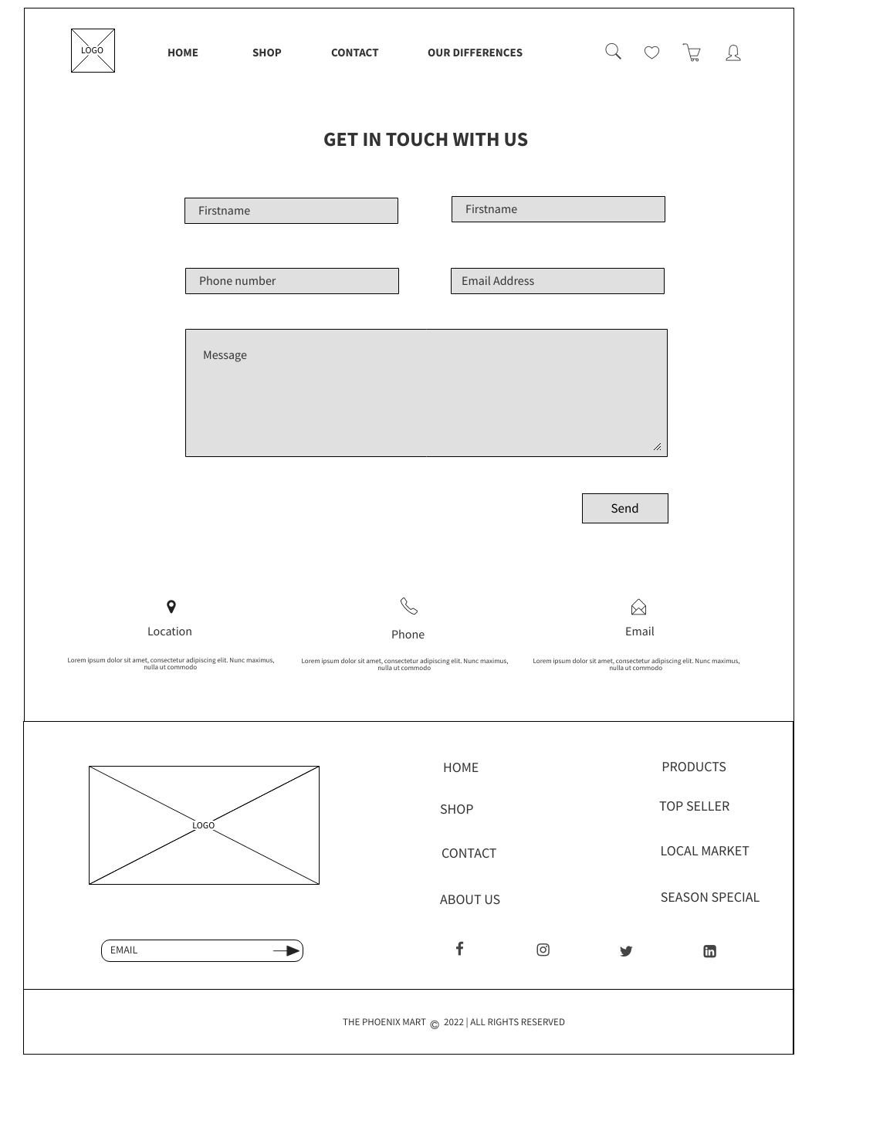
WIREFRAME DESIGN
Product Detail Page
Contact Page

Slide 50
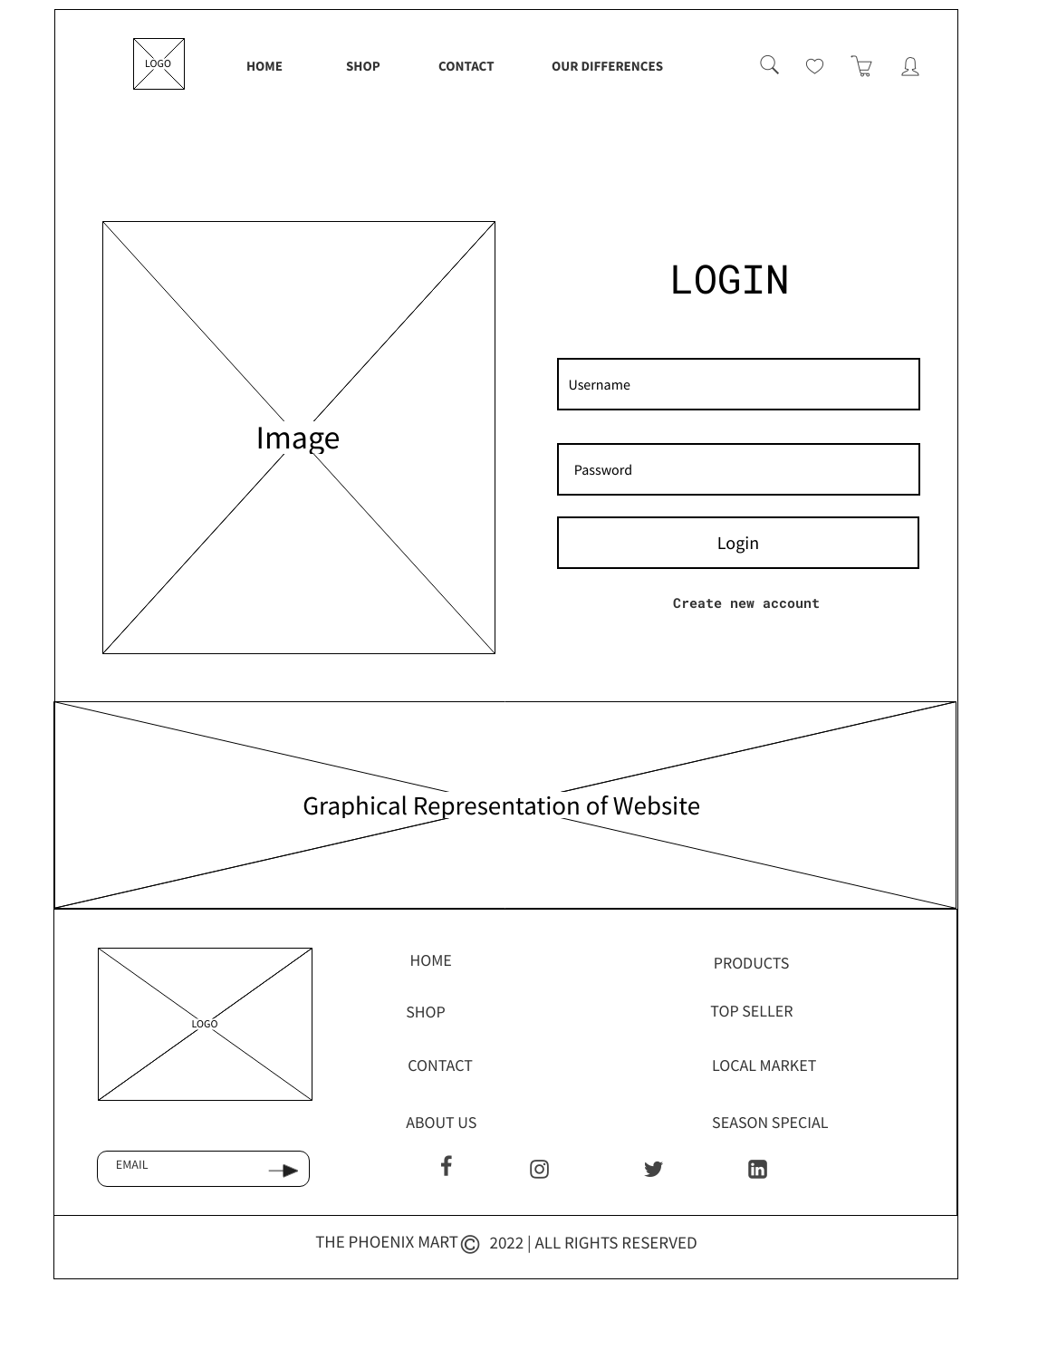
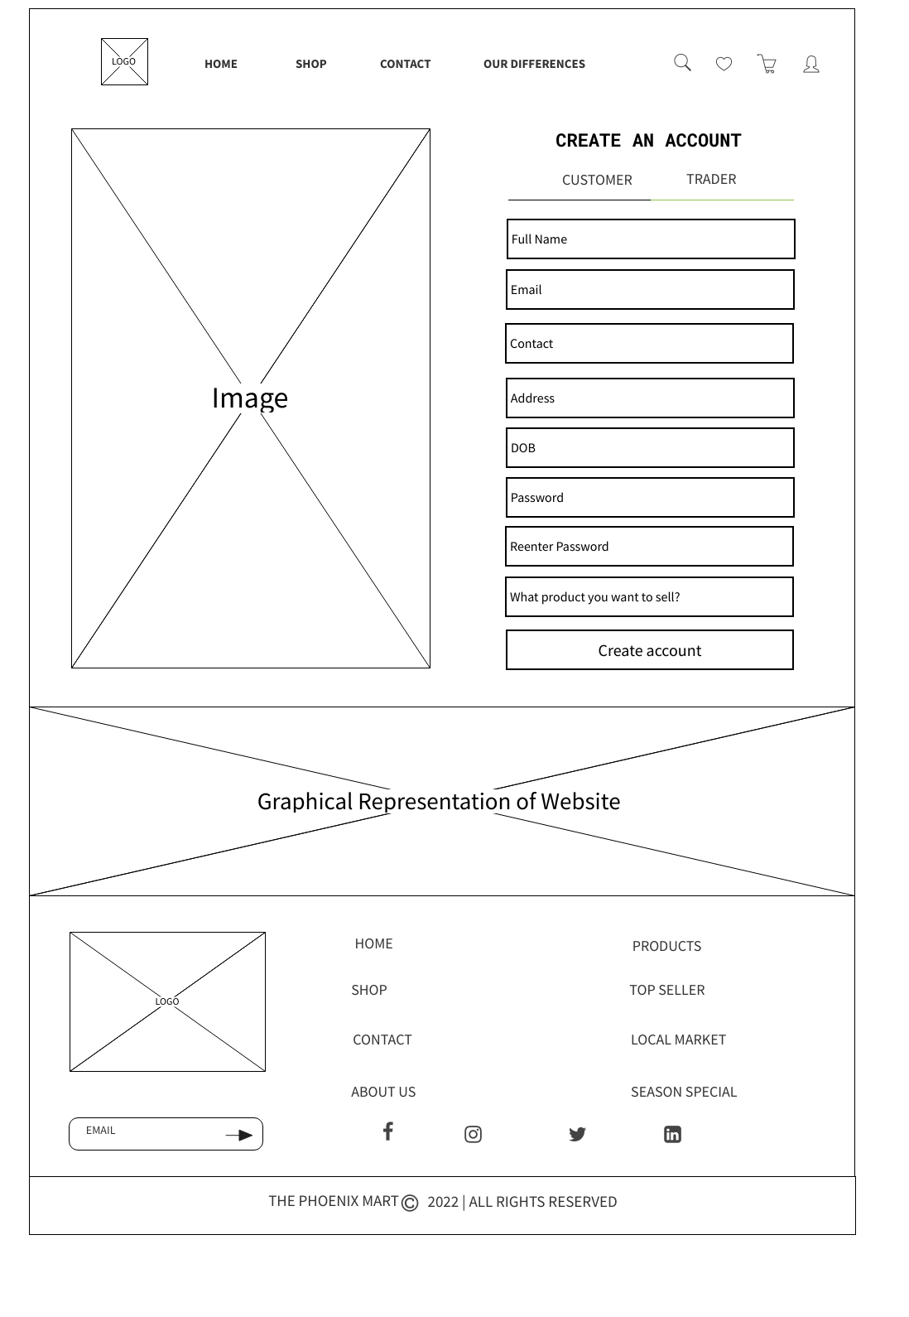
WIREFRAME DESIGN
Login Page
Signup Page

Slide 51
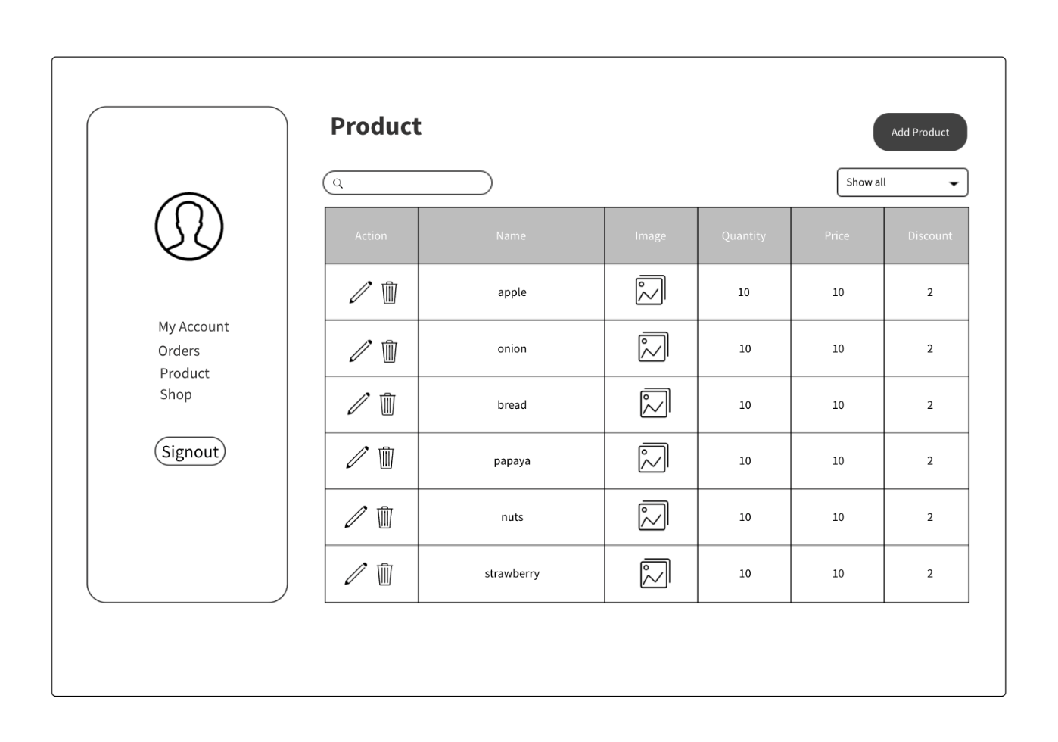
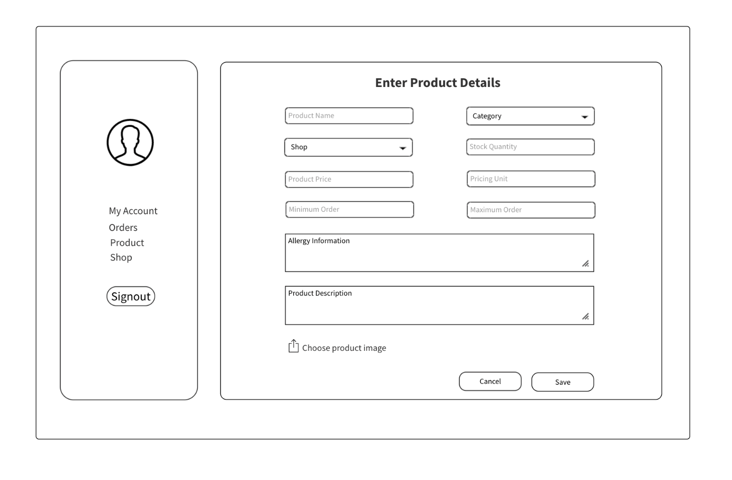
WIREFRAME DESIGN
Add Product Page
Product Page

Slide 52
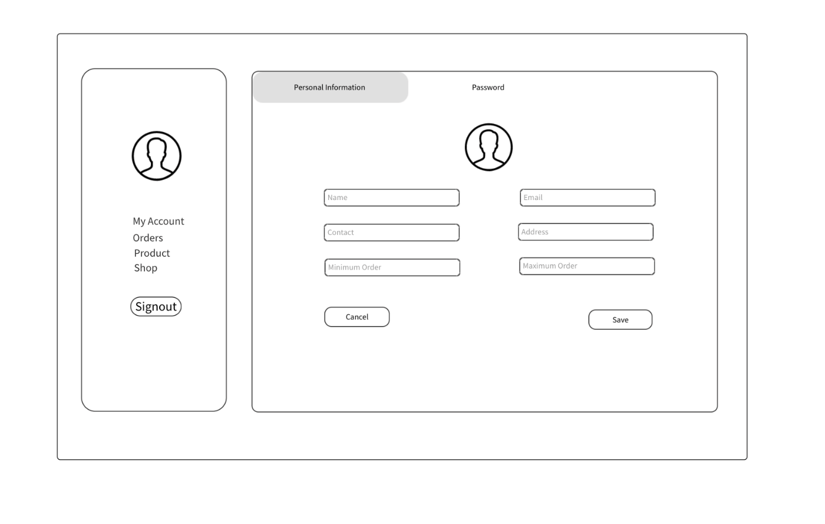
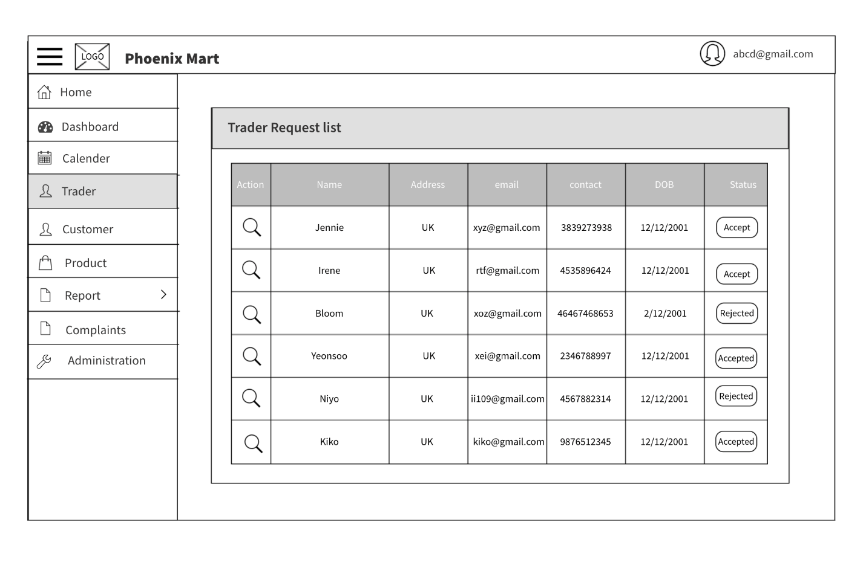
WIREFRAME DESIGN
Trader Profile Page
Add Trader Page

Slide 53
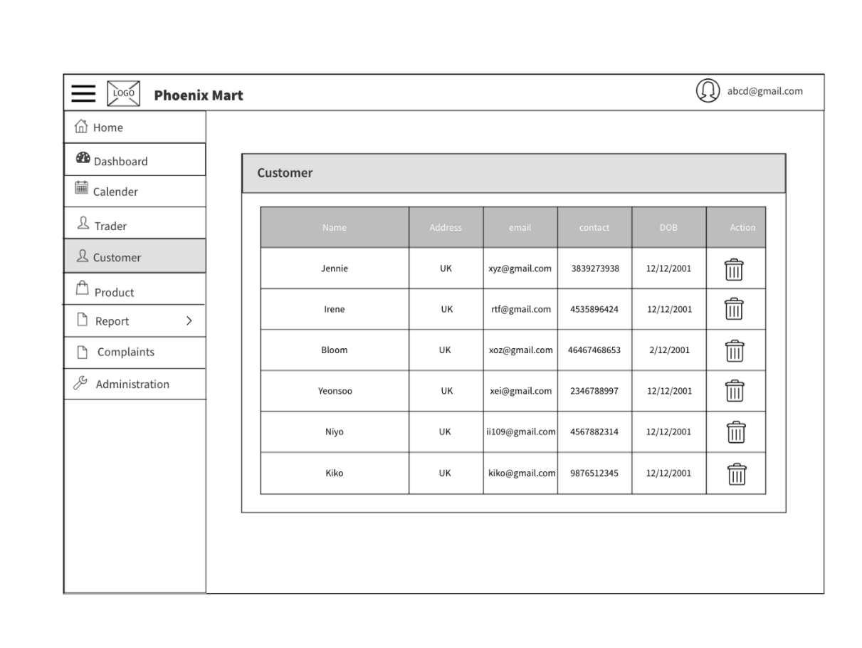
WIREFRAME DESIGN
Add Trader Page
Customer Detail Page

Slide 54
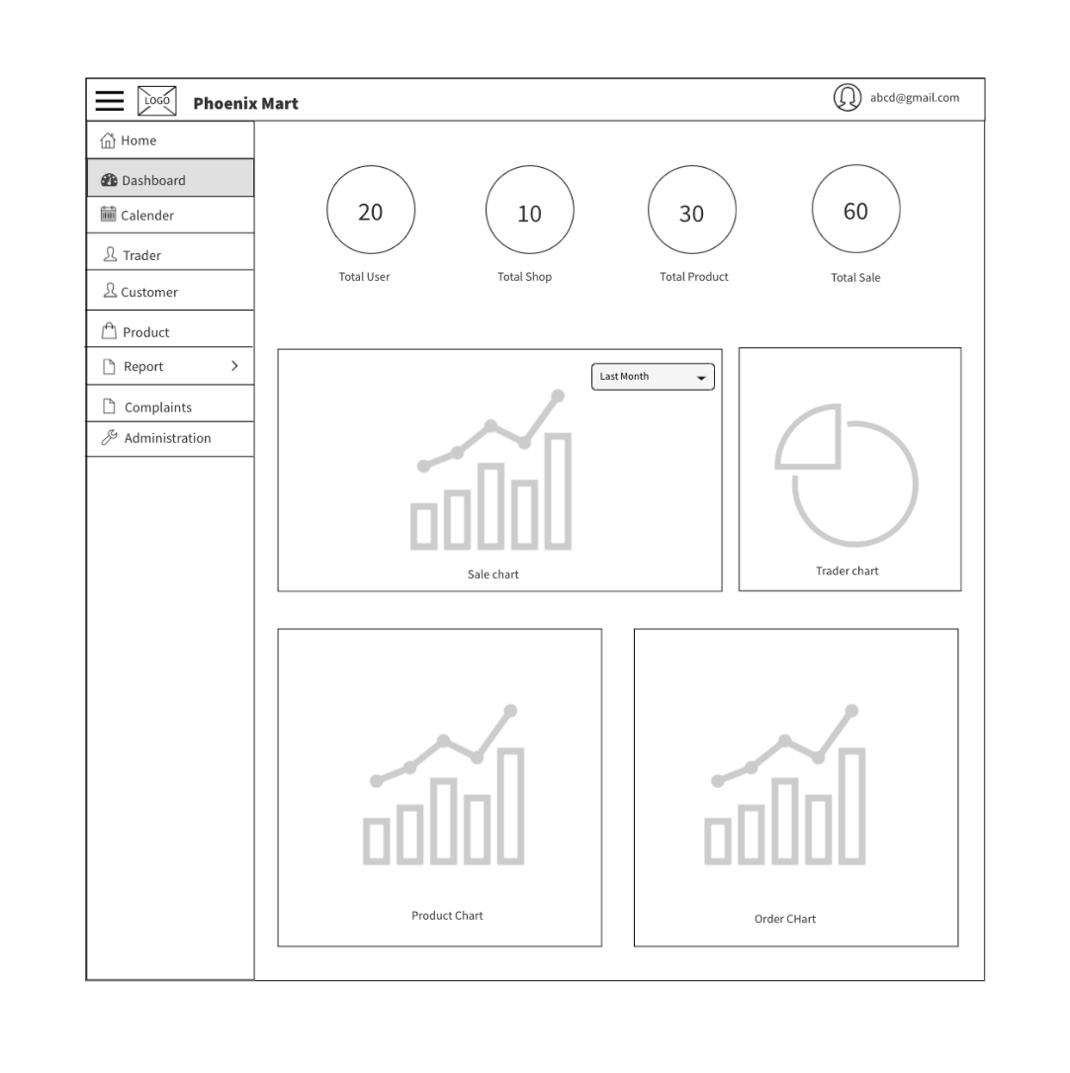
WIREFRAME DESIGN
Admin Dashboard

Slide 55
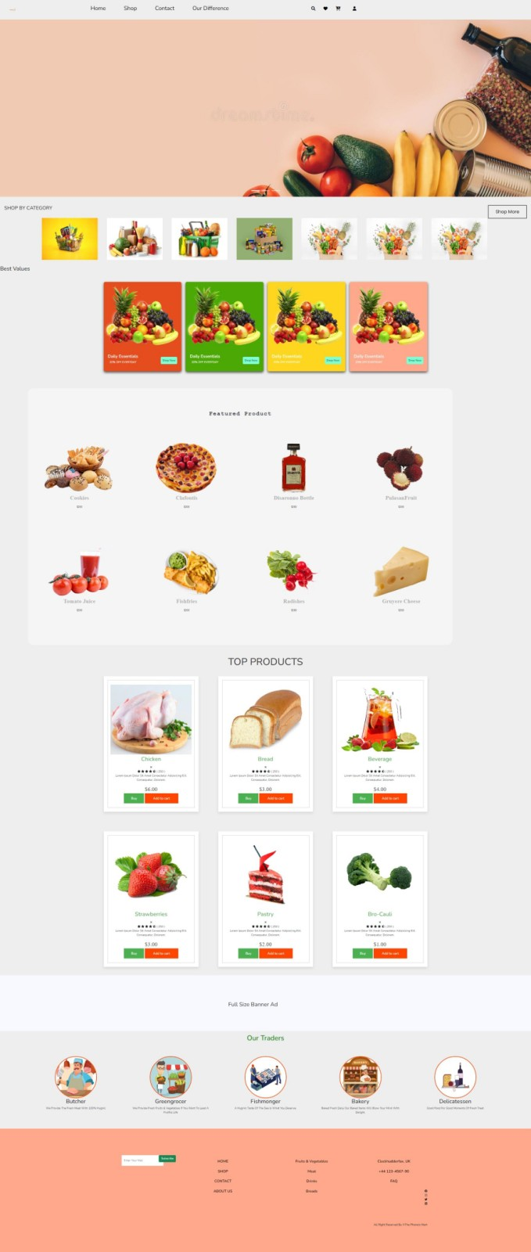

PRODUCT DEVELOPMENT
Homepage(Under Construction)
About Us (Under Construction)

Slide 56
THANKYOU

